Slide 1
Cambodia Teleconference
29 MAR 12

Slide 2
Agenda
Roll Call
Mission Overview – LTC Wooten
Threat – LTC Reynolds
Logistics – CPT Dorema
Questions

Slide 3
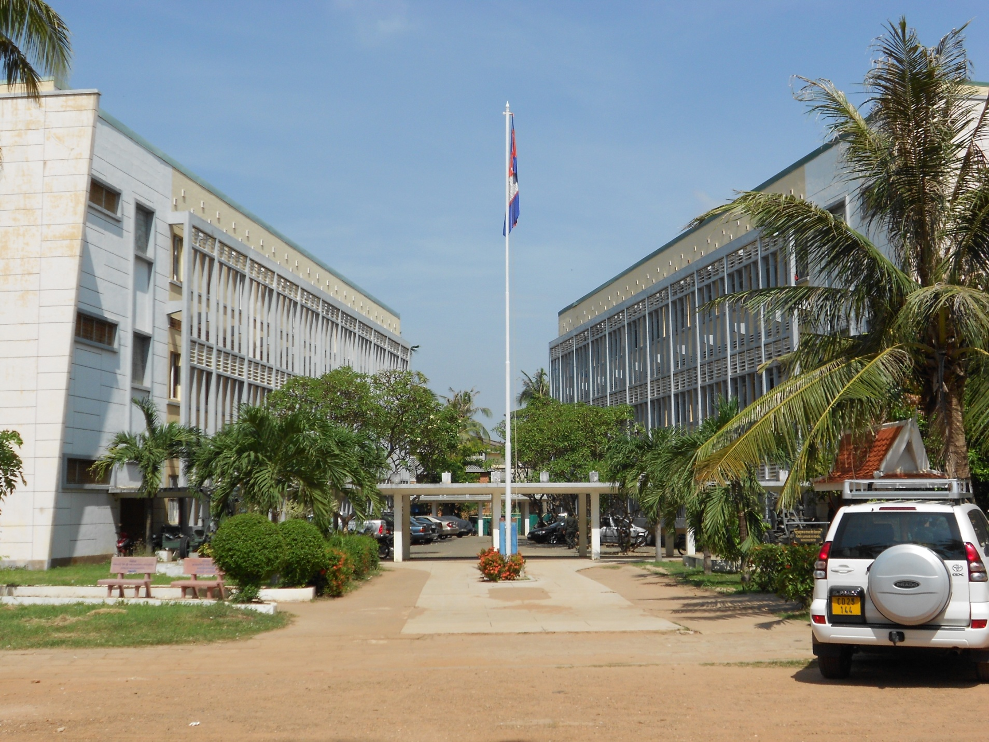
National Defense University – Social Sciences Language Course
Cambodia

Slide 4
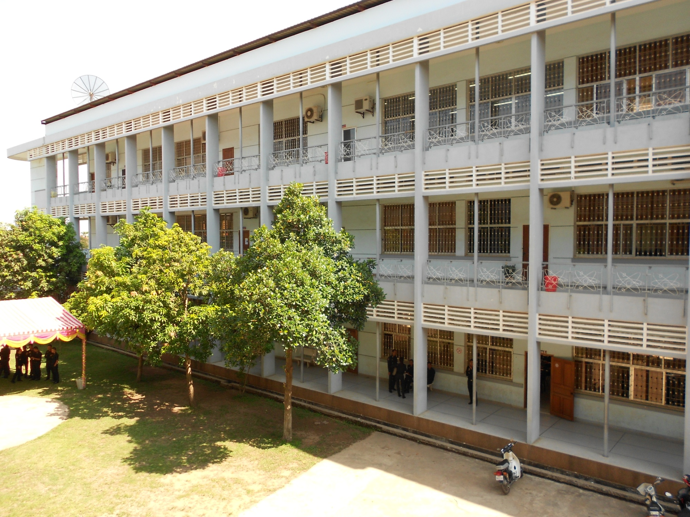
Educational Facilities

Slide 5
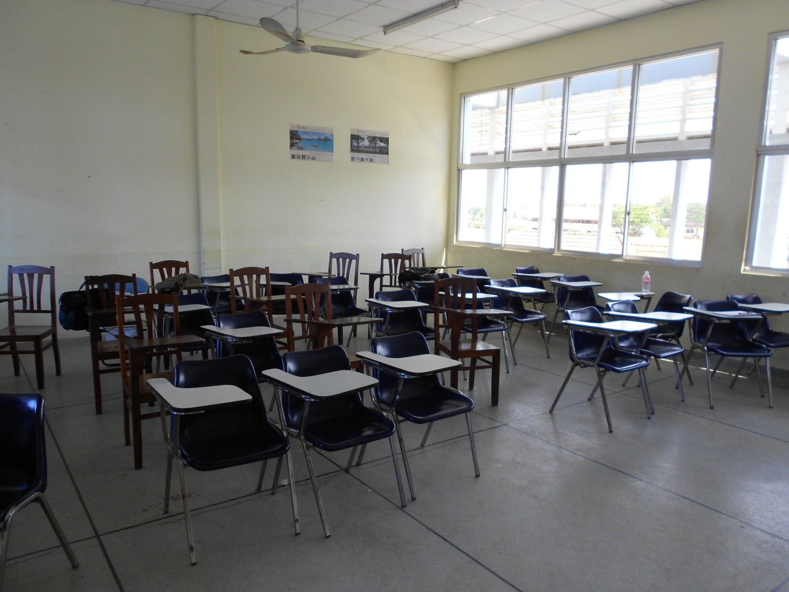
Classroom

Slide 6
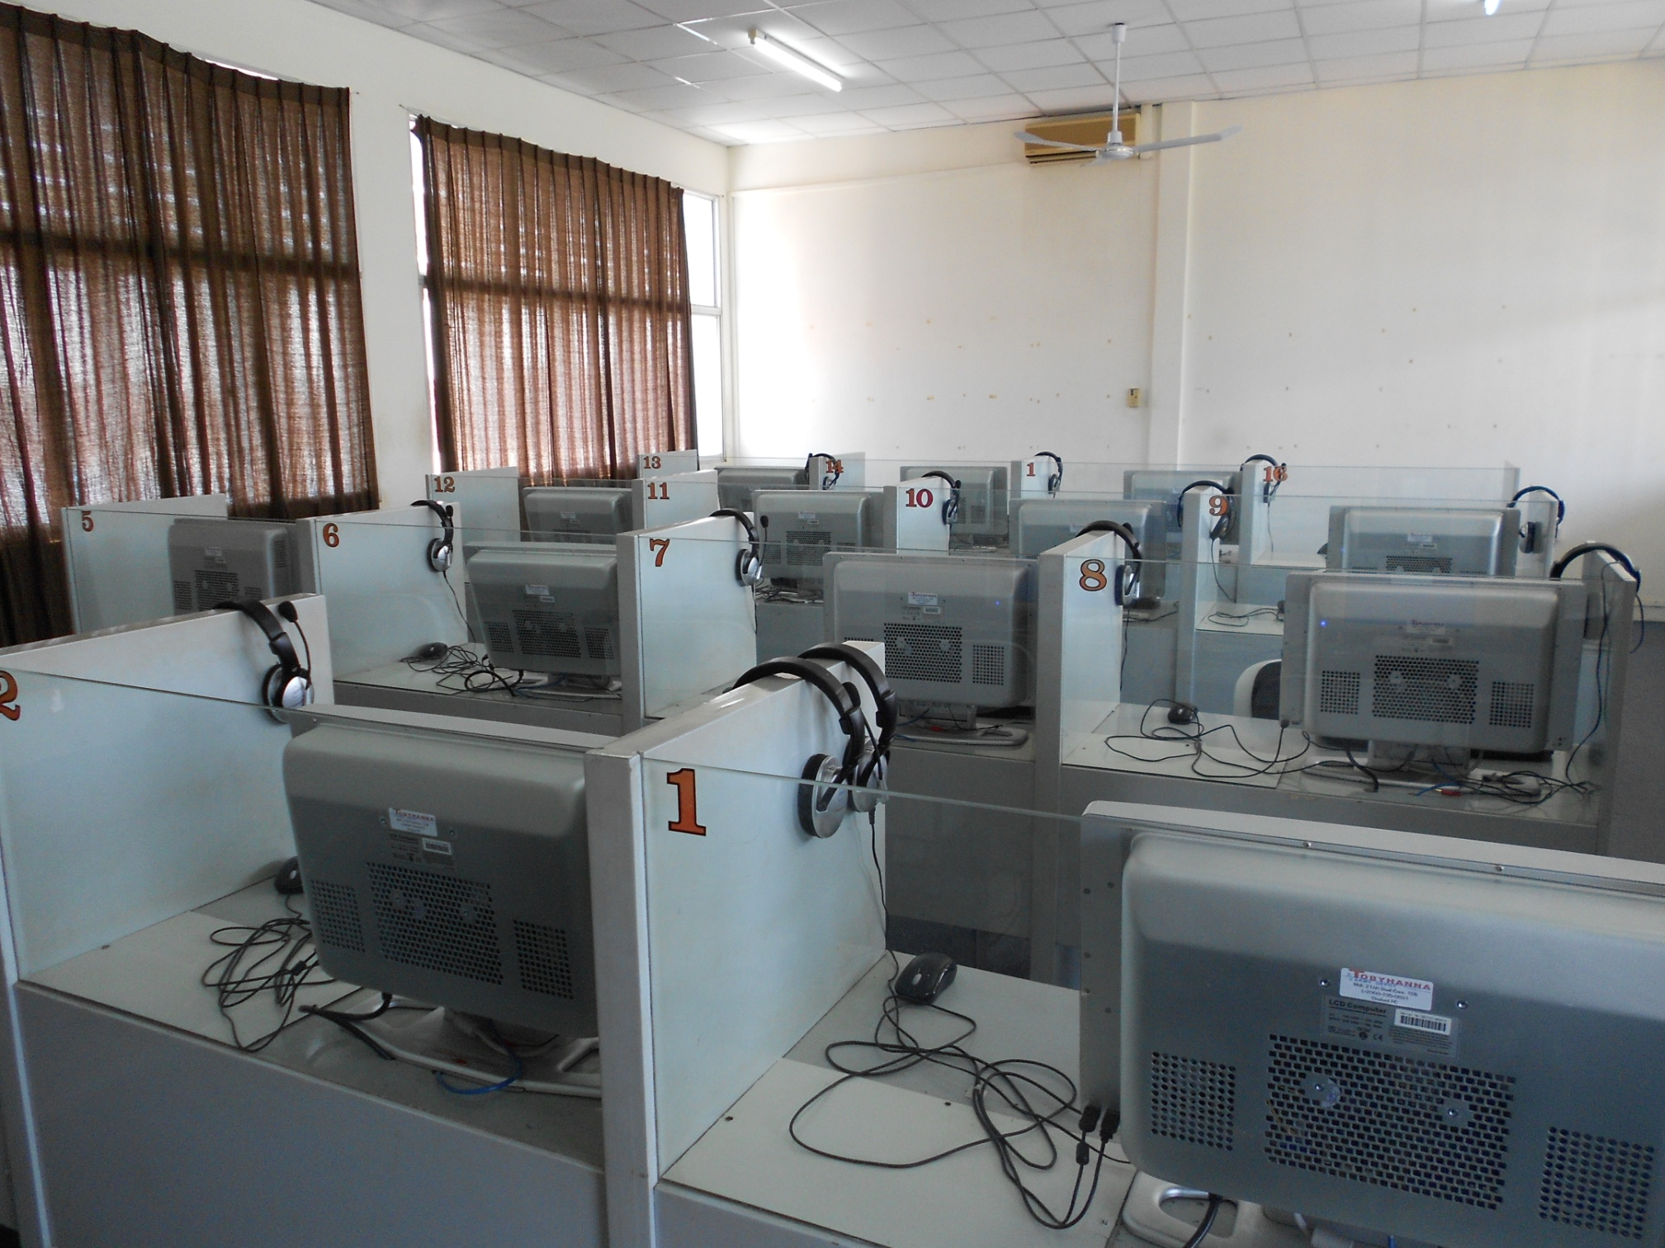
English Language Lab

Slide 7
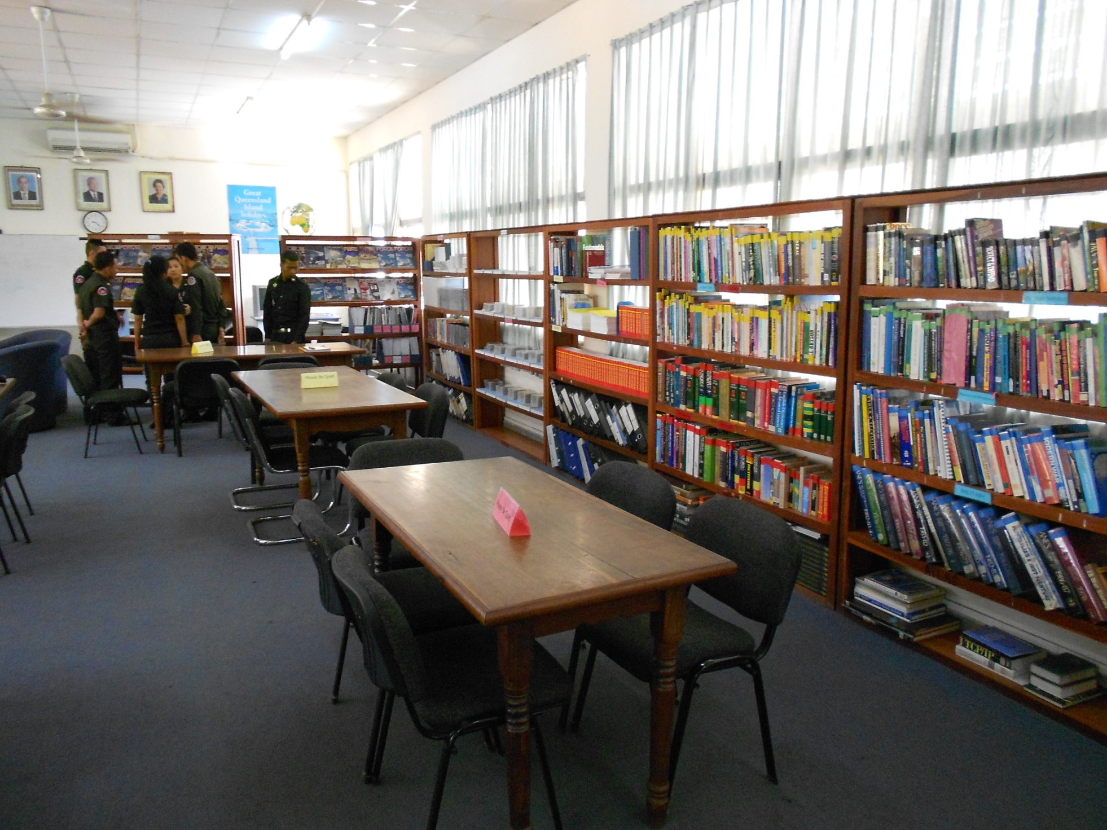
Library

Slide 8
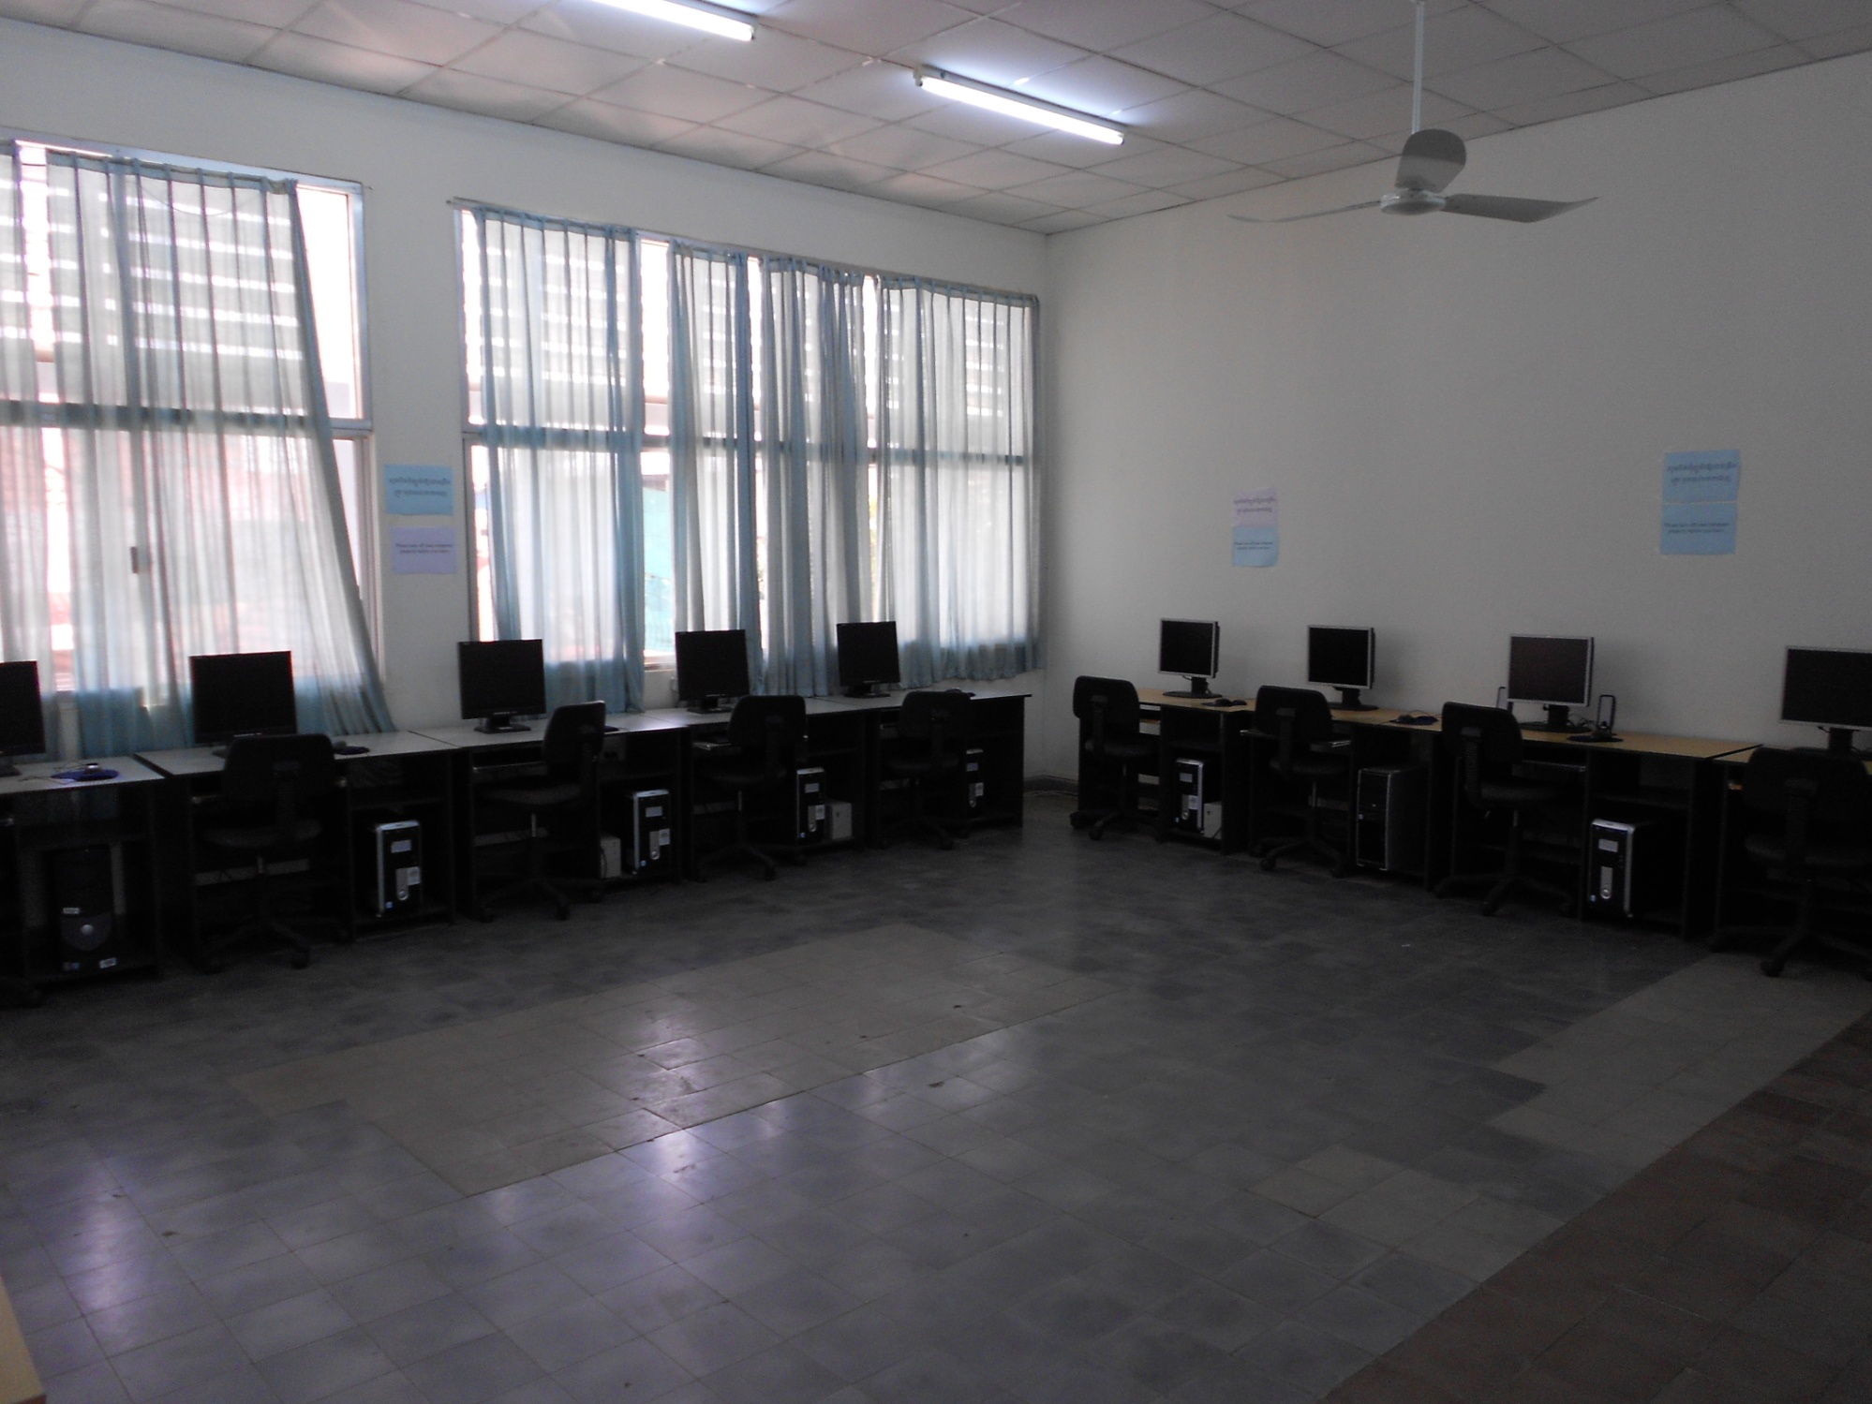
Computer Lab/Internet Cafe

Slide 9
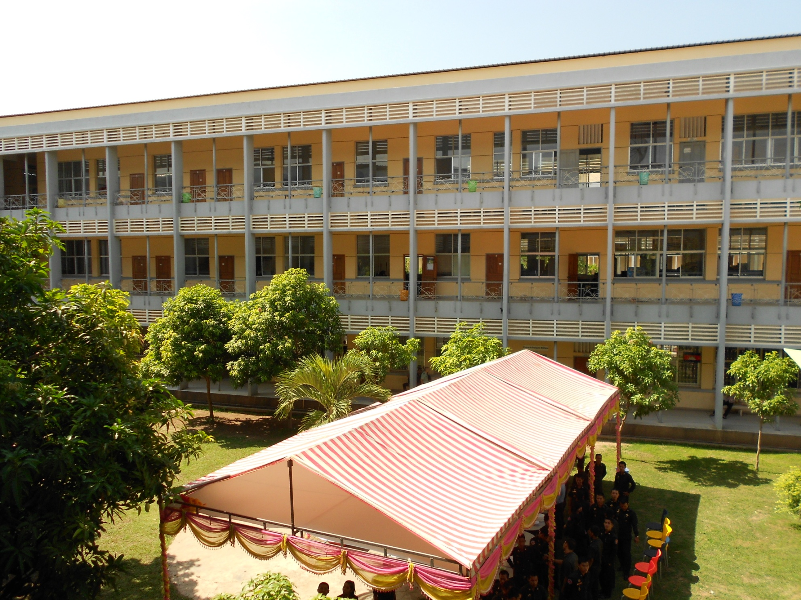
Barracks

Slide 10
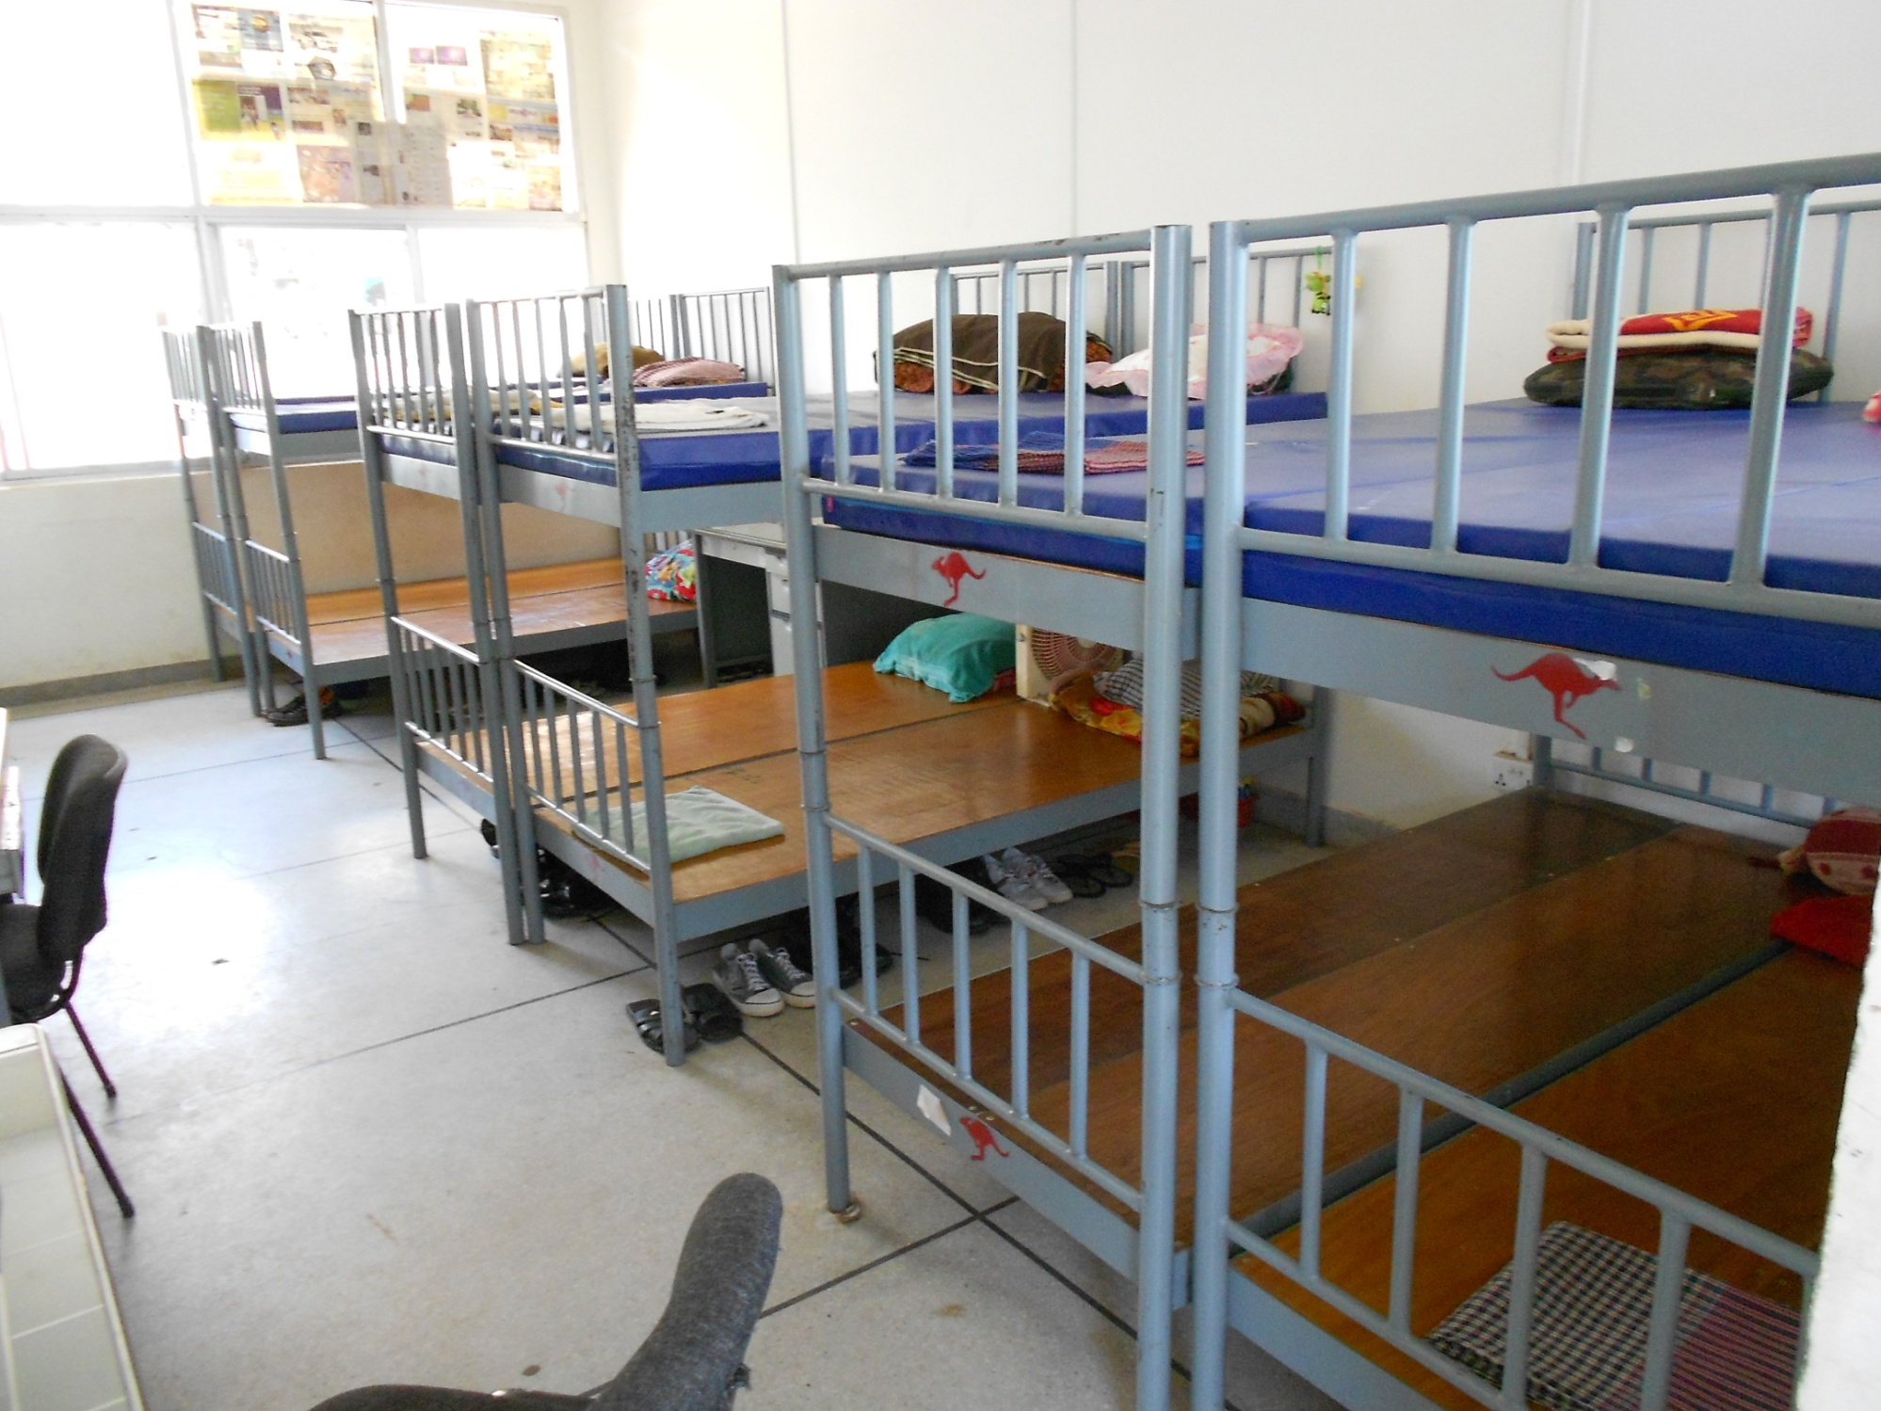
Sleeping Accomodations

Slide 11
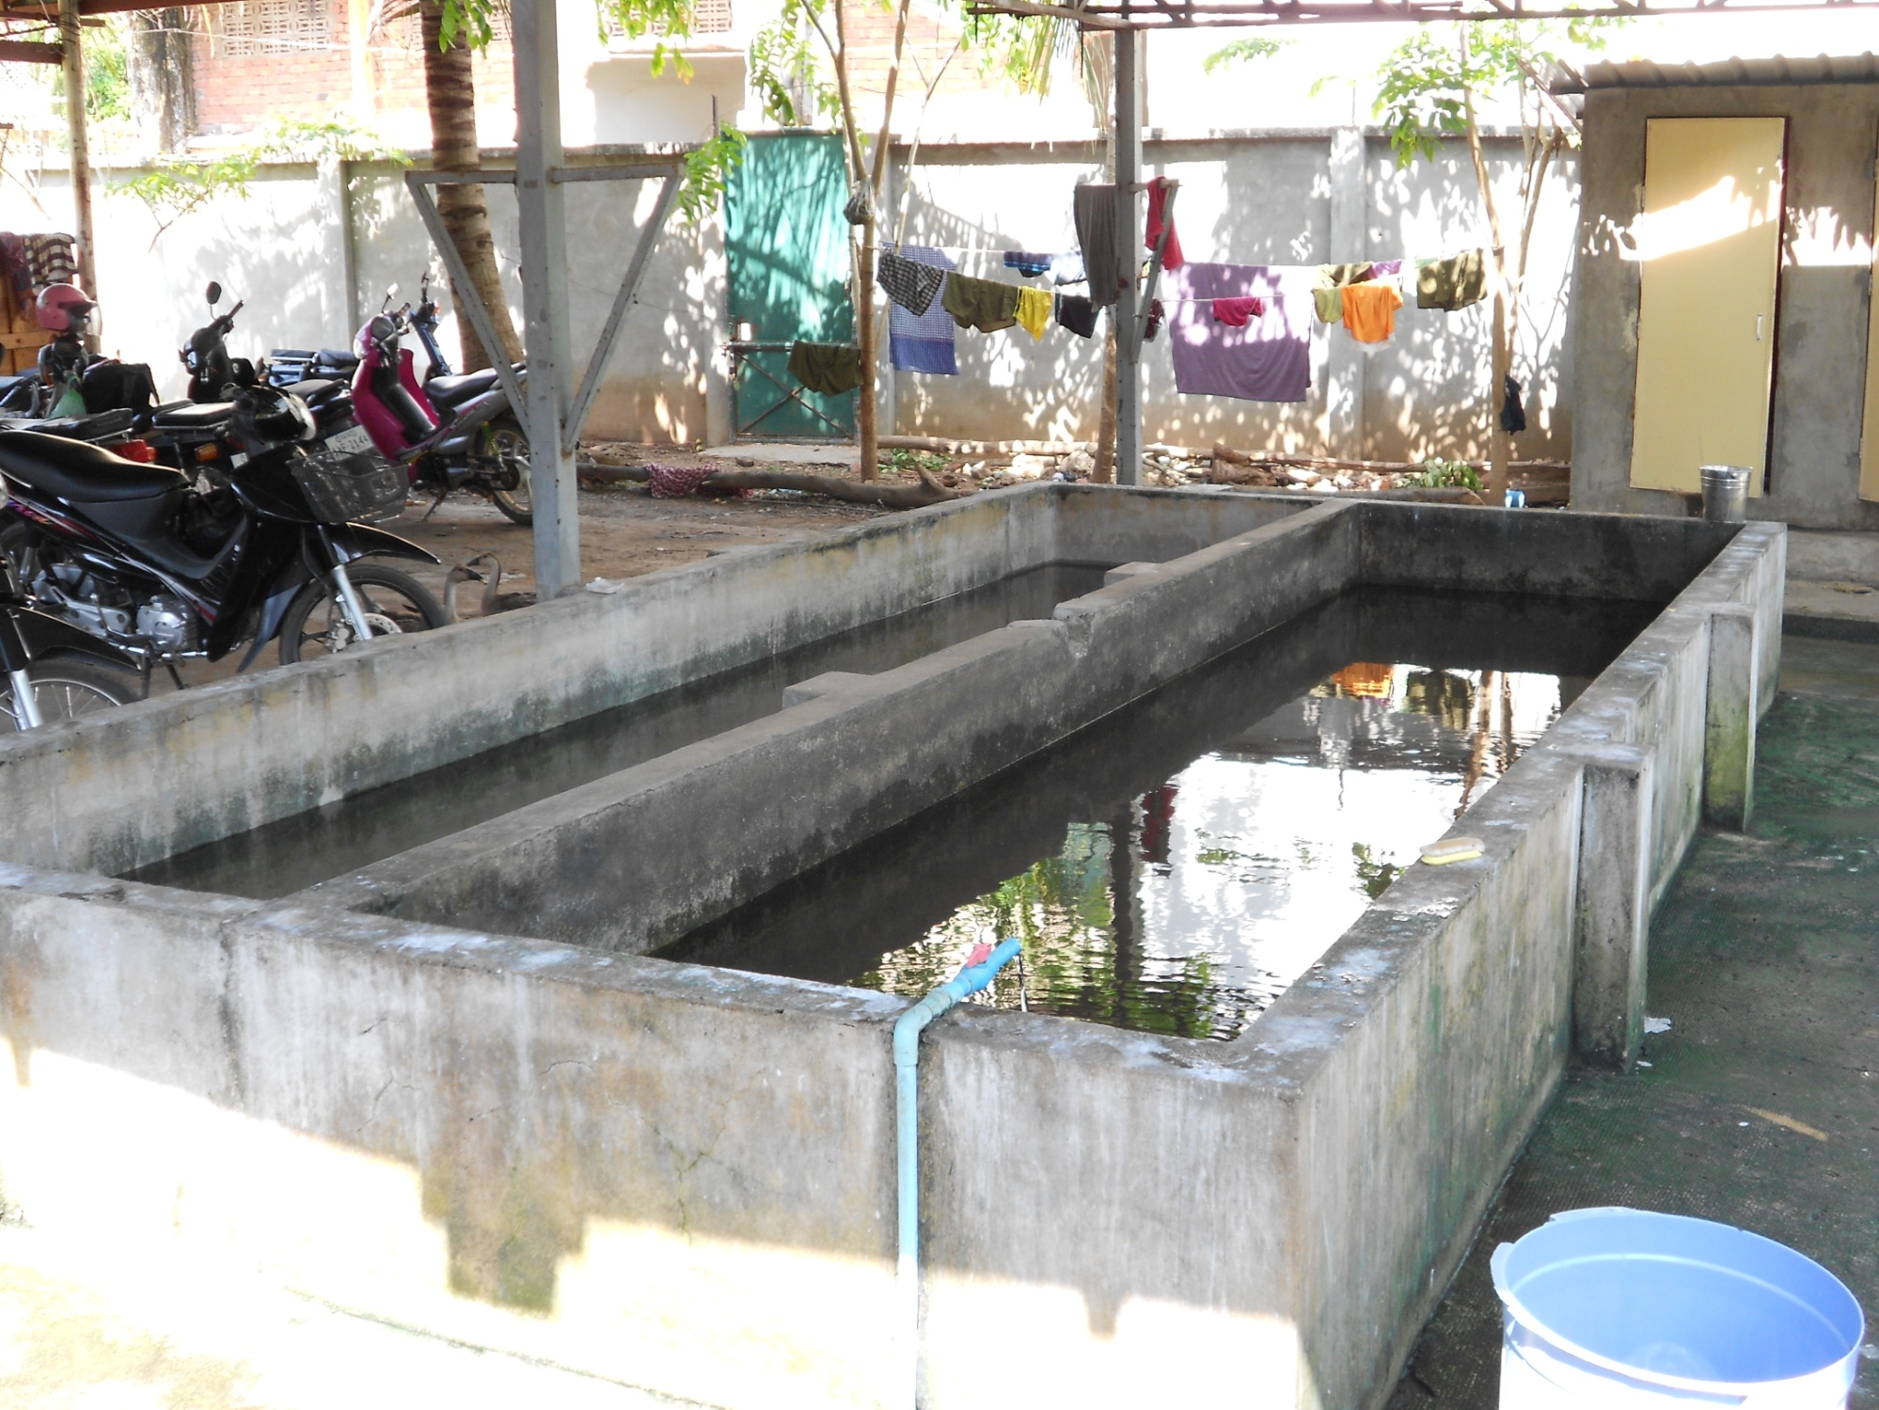
Shower Facility

Slide 12
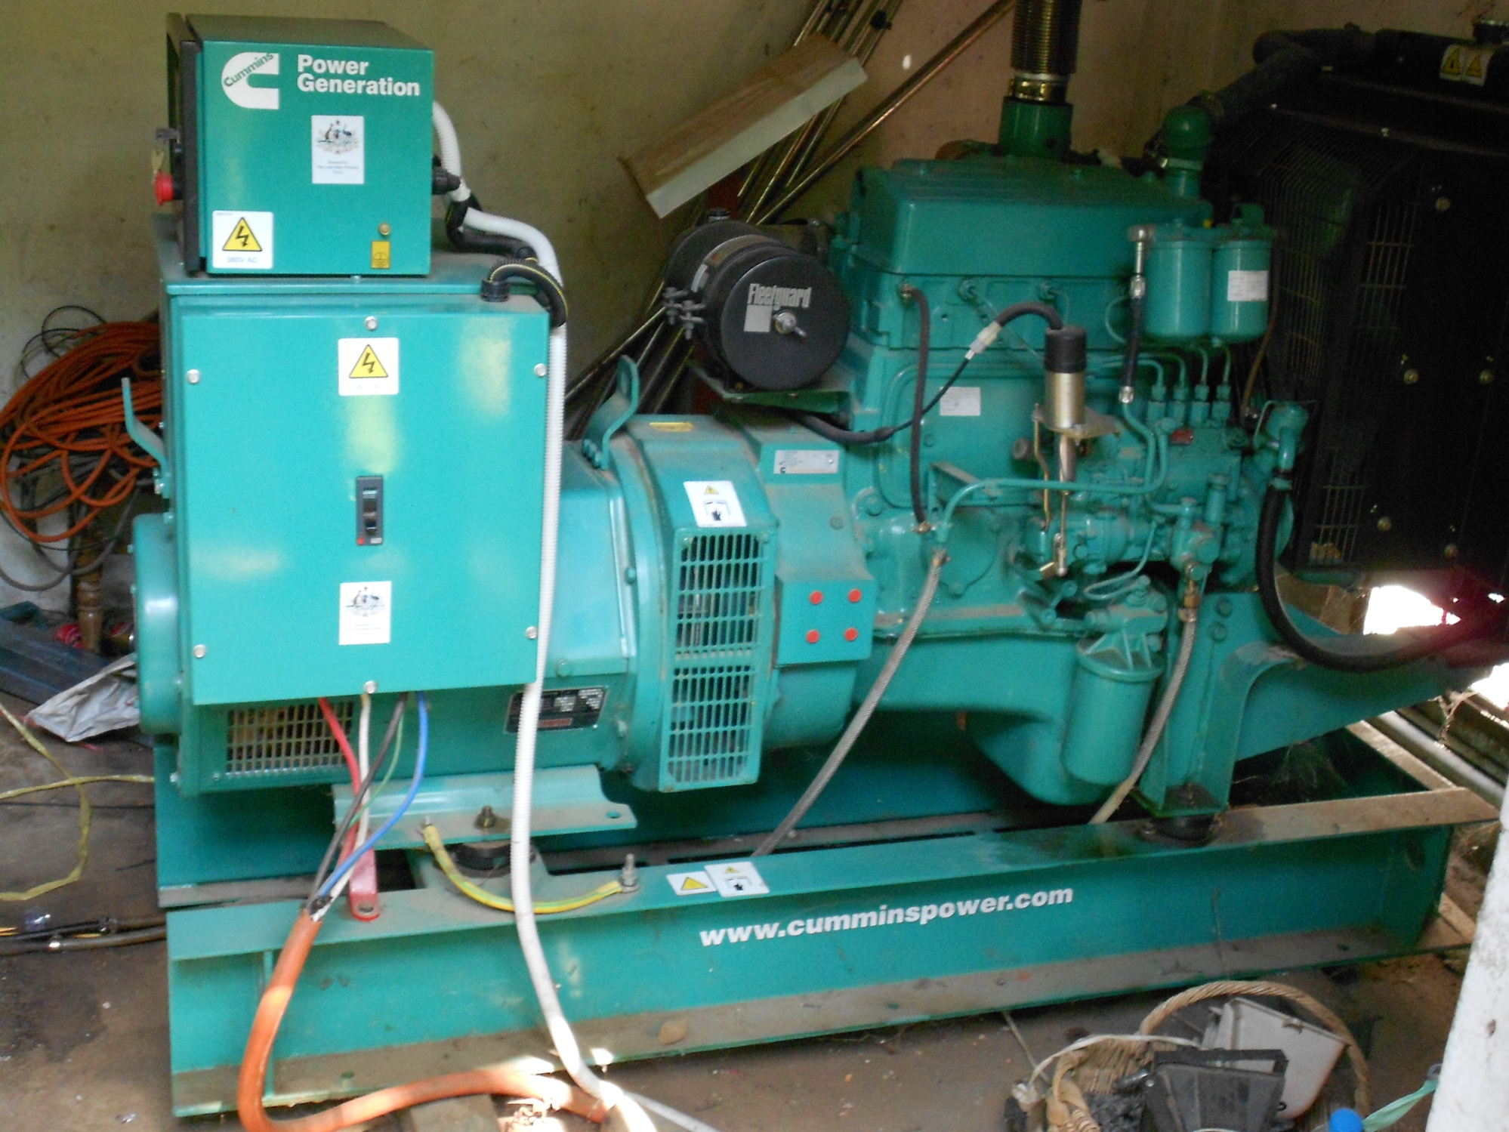
60 kw Generator Powers Entire Facility

Slide 13
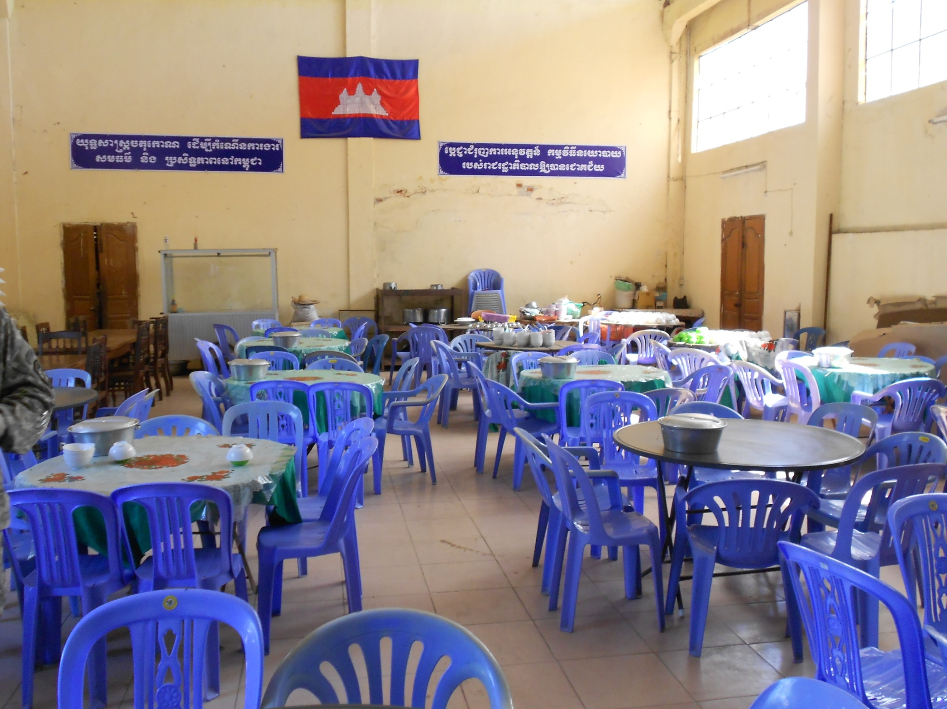
Dining Facility

Slide 14
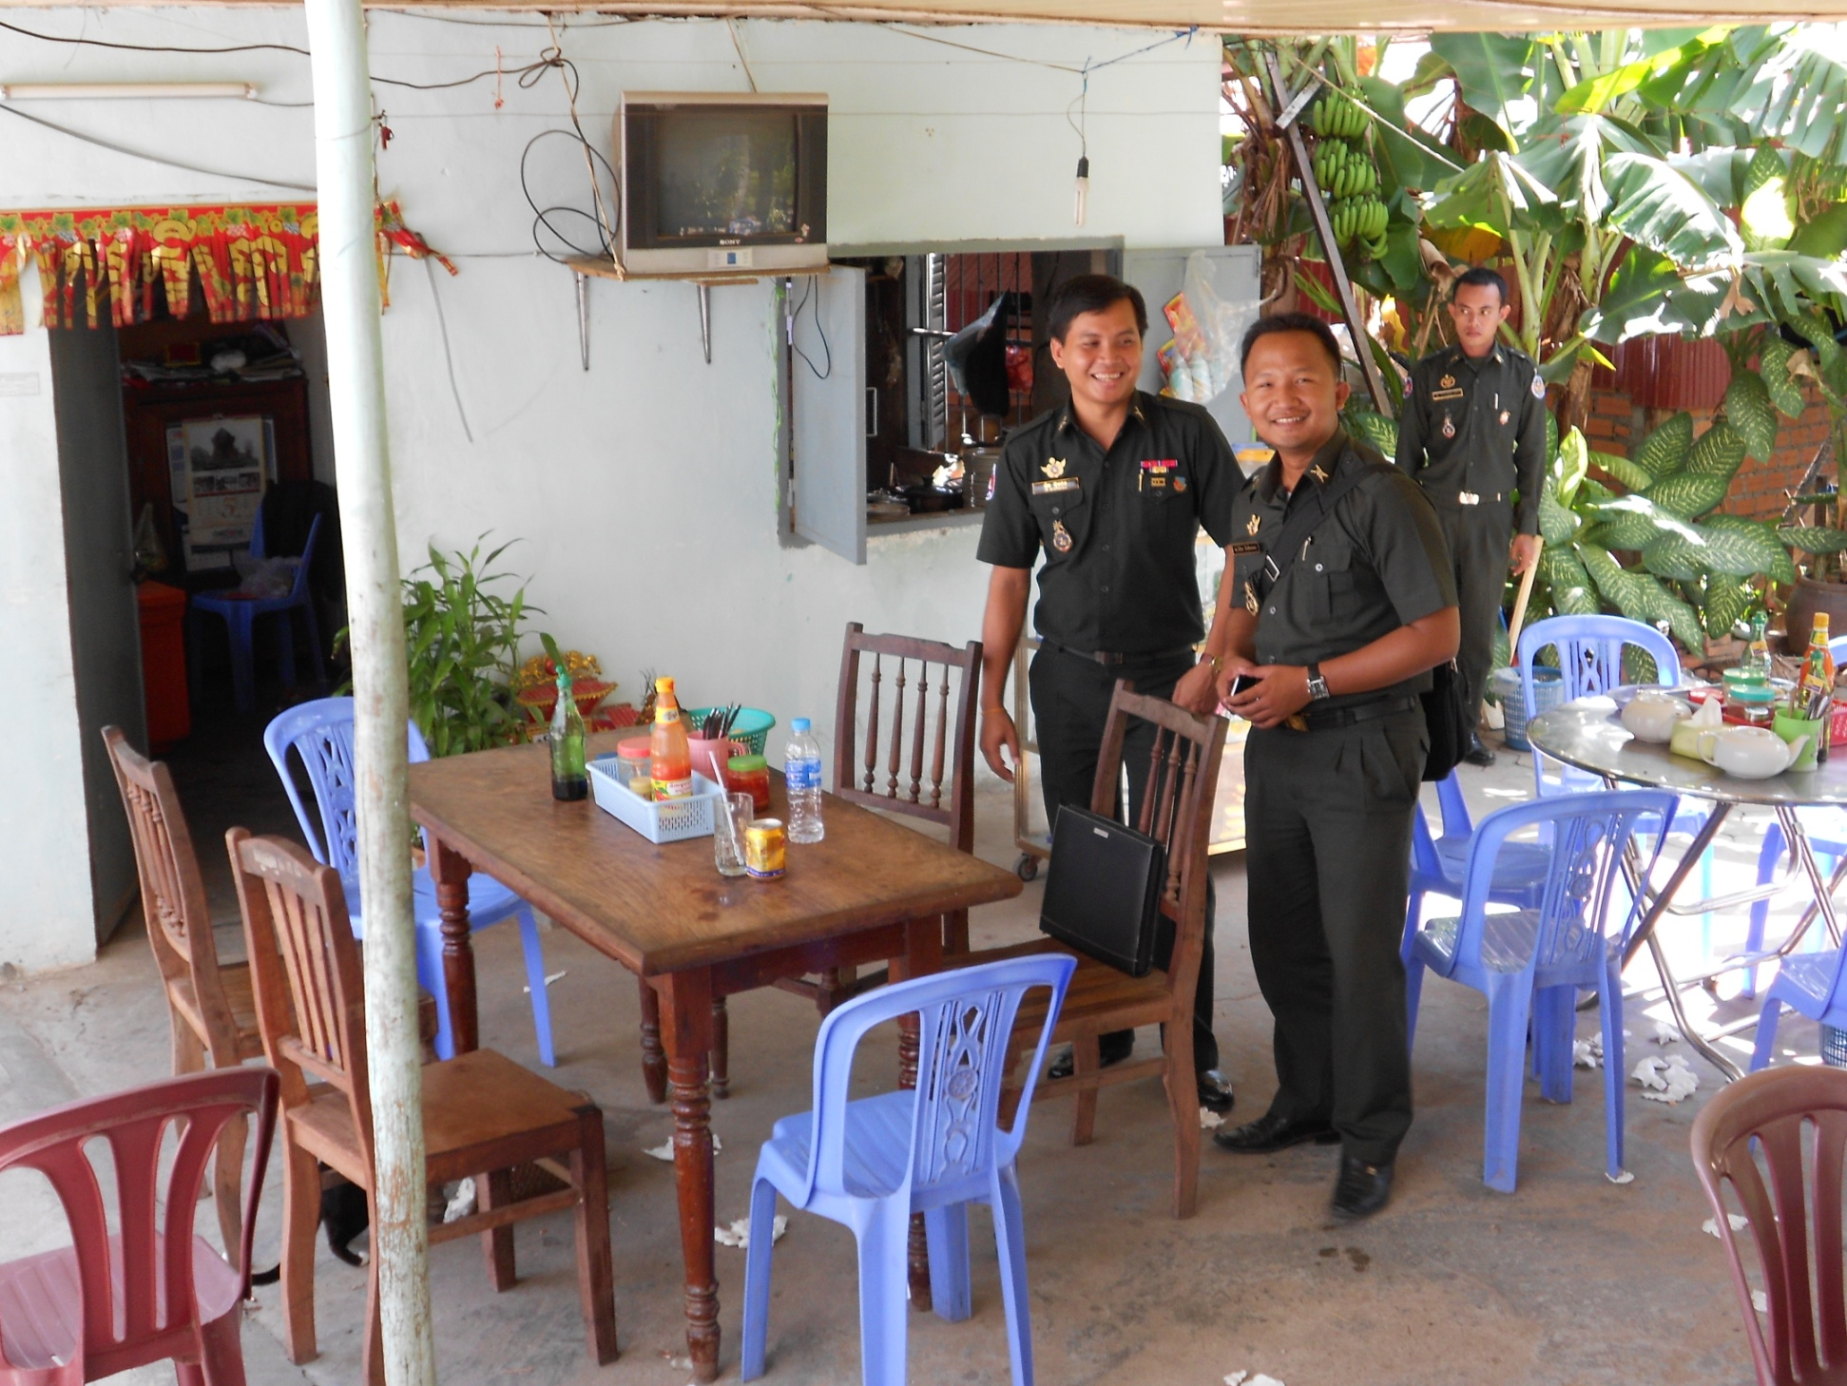
Cafeteria

Slide 15
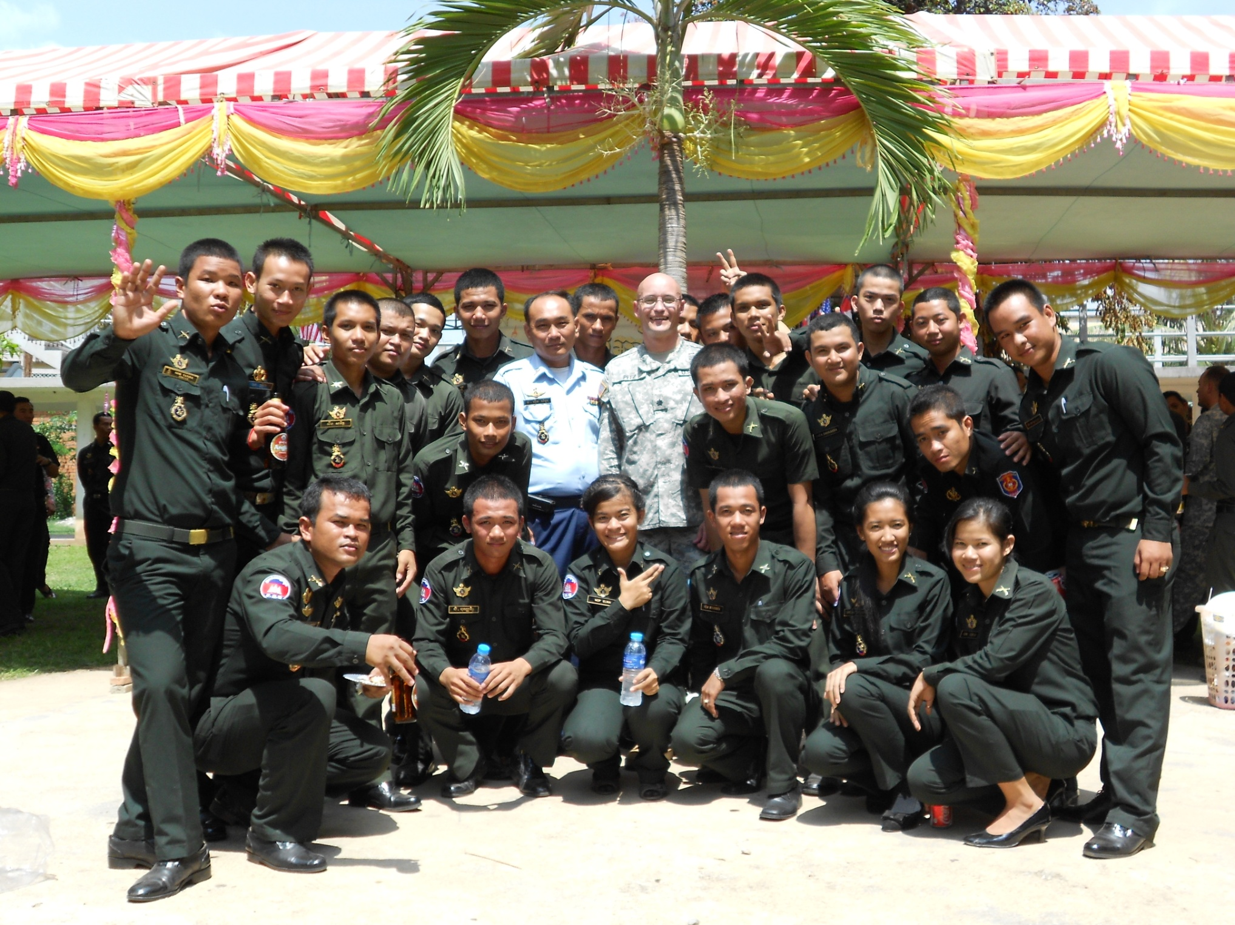
Cambodian Cadets Excited For Our Visit

Slide 16
Threat
LTC Reynolds

Slide 17
Logistics
CPT Dorema

Slide 18
Questions

