Slide 1
Pathways to Resilience
Engaging your congregation and the faith community in building a disaster response team in preparation for a local or national disaster.
Dr. Gretchen S. Kerr

Slide 2
Dr. Gretchen Kerr
Ministry Areas
  Disaster Response
  Prison and Jail Transition
  121Hope (anti-human trafficking)
  Homeless Initiative
  LifeHope – holistic care of the congregation and community in time of need.
  University of Central Florida Masters Social Work (10 clinical interns)
  VISTA (Volunteers In Service To America)
  Service projects
Executive Director, Compassion And Reconciliation (CARe) Center
Longwood, FL.

Slide 3
Resilience
FBO – emotional and spiritual teams provide services which can lower levels of anxiety and depression
FBO Organizations Provide:
  Positive world view
  Personal empowerment
  Sense of control
  Guidance in decision making
  Social support
These are ALL critical resources of community resilience in aftermath of disaster.
The capacity to recover quickly from difficulties, toughness
Notes:
More specifically, faith-based organizations have the ability to play an important role in the response to and recovery from natural and manmade disasters. It has long been observed that
individuals turn to religion and faith-based organizations following catastrophic events. Disaster victims, in addition to the general public, not only use religion and spirituality as a coping tool in
Rivera and Nickels 6 a variety of settings (Yates et al., 1981; Gillard and Paton, 1999; Schmuck, 2000; Smith et al.,2000; Greene, 2002; Banerjee and Pyles, 2004; Bankoff, 2004; Lawson, 2010), but also as a way to explain and understand disaster events (Kroll-Smith and Couch, 1987; Hutton and Haque, 2003; Chester, 2005). Psychologically, faith-based organizations and the spiritual services they provide have been shown to lower levels of anxiety and depression (Schuster et al., 2001; Trevino and Pargament, 2007) by providing a positive world view, personal empowerment, a
sense of control, guidance for decision making, and social support (Koenig, 2006) which have been shown to be critical sources of community resilience in the aftermath of disasters (Weiss et
al., 2003; Koenig, 2006; Alawiyah et al., 2011).

Slide 4
Lessons Learned
Start Small
Reflect your DNA
Partner – Partner – Partner
Go where called
Their agenda not yours

Slide 5

Start Small
The History of Northland’s Disaster Response Team
Notes:
First start small. The inclination is to hear presentations and think, I could never do what they are doing. I have felt this myself. Realize this ministry have been growing for over 10 years.

Slide 6
Response: 2004 - present
Local & National Response
8/2005 Hurricane Katrina
9/2005 Hurricane Rita
1/2010 Haiti Earthquake (5 months)
4/2011 Pleasant Grove, AL. tornado
4/2011 Tuscaloosa, AL. tornado
10/2012 Hurricane Sandy, Far Rockaway, NY.
5/2013 Moore Ok, tornado
Our Community Response
8/2004 Charlie, Francis & Jeanne
2/2007 Lake County tornado (21 deaths)
8/2008 TS Fay (local flooding)
6/2012 TS Debby, Live Oak, FL.

Slide 7
Major Ministry Milestones
2004
2005
2010
2011
4/2012
2012
2013
Begin journey
Of responding
To local and
National
disasters
Develop
Local
Partnerships
With
Emergency
Management &
Community
Partners
Develop
Structure
Deploy
Forms and Process,
Required
Deploy
training
CERT,
Began
Regular
Training
Process
And
Events
To
Train
26’ Mobile
Kitchen
arrives
Travel out
of state to
Major
events
Aware of and
called to
Local
events
Notes:
Sat on long term recovery committee, established local VOAD (volunteer organizations active in disasters), partnerships with local emergency management organizaitons.
CERT

Slide 8
Small Humble Beginnings
2004 – 2007 ministry was in the formative stages
Katrina response (2005)
  Early beginnings of formative ministry
  Congregation supported through contributions
  Teams sent to assist in with rebuilding – Partnerships develop
2010 Haiti Earthquake
  Partnered with other organizations
  Formalized deployment, training, credentialing
  Deployed 50 team members over 5 months

Slide 9
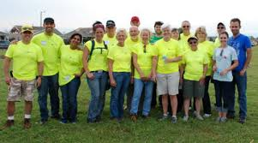
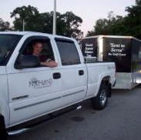
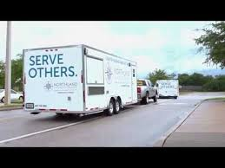
Start small; grow as God leads
2004 partnered with others using equipment
2005 trailer for building in Gulfport, Al – New Orleans, LA
2007 donated 2nd supply trailer
RBHAT – ESF8 following Haiti
2010 CERT members
2012 Purchased mobile kitchen (borrow truck to pull it)
2013 added large supply trailer
2014 Leased truck

Slide 10
Reflect Your DNA
The History of Northland’s Disaster Response Team
Notes:
START SMALL – Then Reflect Your DNA

Slide 11
Understand your niche
Started by partnering with others – responding as needed, often in cleanup phase.
Developed experienced teams (over time). Shelter Management teams to support our local high school (Red Cross)
Created teams to support EM POD’s at Local malls. The National Guard respond during 1st 72 hours, then our teams would take over.
Took on new members and partner with experienced professionals (multiplication).
Eventually transitioned from responding 2-4 weeks following event into more immediate responders .
New niche, were able to roll equipment within 24 hours
stay onsite until community stabilized (typically 14-18 days).

Slide 12
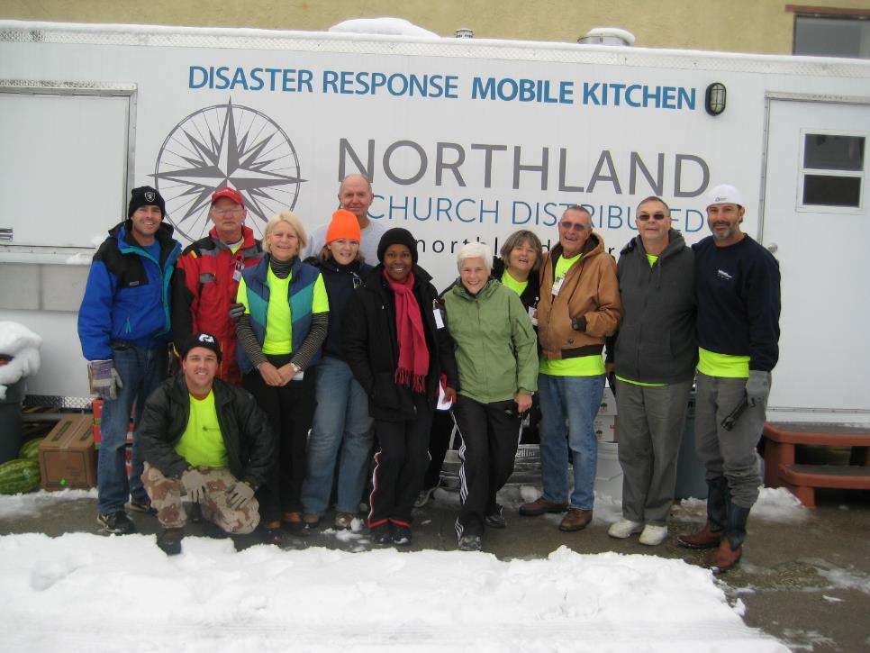

Slide 13
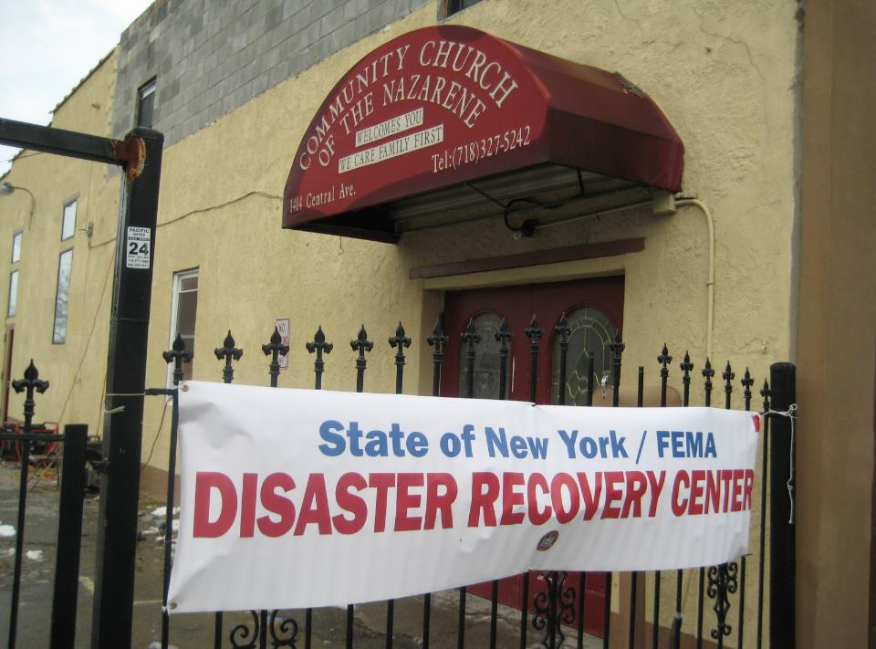

Slide 14
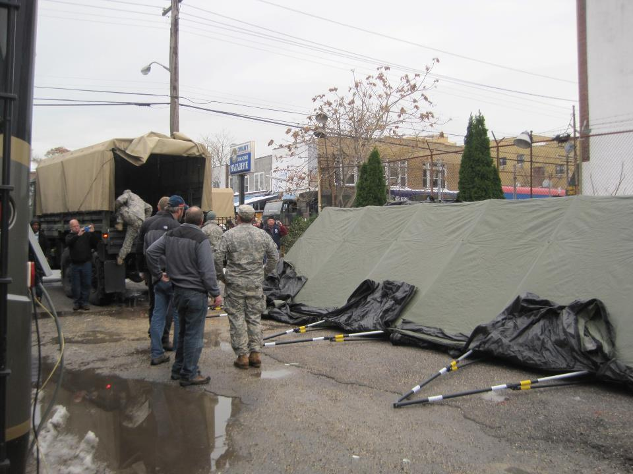

Slide 15
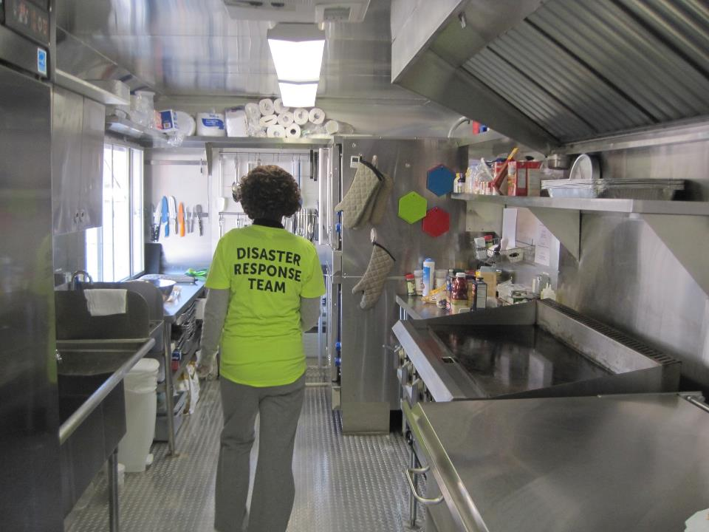

Slide 16
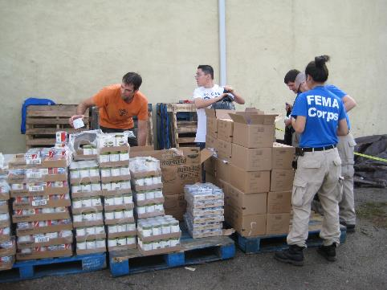
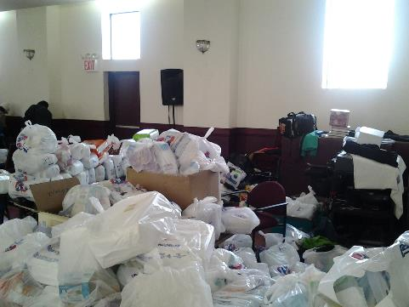
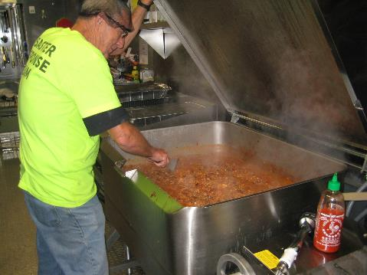
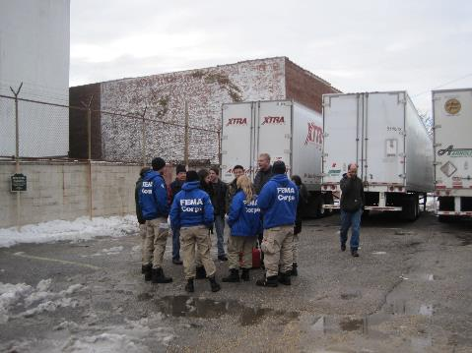

Slide 17
How to Build a team?
Slow and steady
Annual events to raise awareness and recruit
  Disaster Response Awareness day (May – prior to hurricane season)
Local outreach events used as training for teams
  Orlando International Airport – Full scale event – mobile kitchen
  Local organizations – events
  Community block parties – mobile kitchen provides food

Slide 18
Team Development
Monthly pot luck meetings – fellowship, training, information sharing
Skills Course – two sections – offered twice a year. Each member must review each year. Provides level of commitment
CPR – Disaster Response team provides training (licensed under City of Orlando Fire Department)
  Child Care workers
  All Disaster team members
  Community members
  Congregation members

Slide 19
Partner
Partner
Partner
The History of Northland’s Disaster Response Team
Notes:
START SMALL --- Reflect Your DNA -- Partner

Slide 20
Community Partners
Local Emergency Management (County, City)
  Seminole County Long term recovery organization
  Tri-County VOAD
  City of Orlando EM – CERT training, weather spotter, 311 operator training, CPR certification (in house)
Other Faith groups
  Train with us, serve on our teams, deploy with us
Share resources and network with other churches

Slide 21
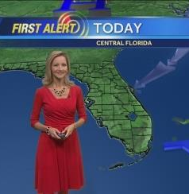
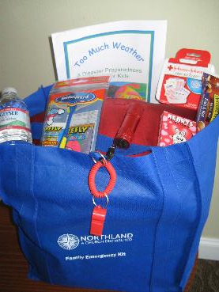
Awareness – Build a Kit
WESH 2 Meteorologist Amy Sweezy guest at event
Kids received instruction on all items
Visit tables, answer questions on item, put in bag to create family kit
Fun, food, entertainment

Slide 22
Go Where Called
The History of Northland’s Disaster Response Team
Notes:
Start Small – Reflect Your DNA – Partner Partner Partner

Slide 23
Patience
Ministry philosophy
DR@N (Disaster Response at Northland) team is made up of various levels of trained congregants.
All are welcome – at all levels
Team spans experience levels from within congregation:
  fire chiefs and professionals
  Restaurant professionals; chefs
  Construction workers, mental health professionals, etc.

Slide 24
Teams – based on skills
Kitchen Team
  Food Handlers certification, Kitchen manager certification
Emotional and Spiritual Care team
  Psychological First Aid, NOVA, CISM trained
Equipment & Debris Removal team
Medial team (professionals)
Behavioral Health Assessment team (Dept. of Health)
Pet Care

Slide 25
Deployment
Deployment based upon being “invited” to assist.
Priority given to requests from churches in effected areas.
All team members understand the idea of spontaneous volunteers – we only serve as a deployed team.
Basic FEMA classes required for deployment (IS100, 200, 700, 800).
  Teams understand common language, chain of command, etc.

Slide 26
Reflect Their Agenda: not yours
The History of Northland’s Disaster Response Team
Notes:
Start Small – Reflect Your DNA – Partner Partner Partner – Go Where Called
And Last. Reflect their agenda, not yours.

Slide 27
Our Team Guidelines
Assist the host site as needed
  Train and educate if needed, we want to empower them to multiply their skills in the future
  Set up procedures they can maintain after we leave (our stay is 10-14 days)
Show Hospitality and respect for host locations
We are there to serve our host site (not the other way around), they have just experienced trauma
Each deployed team member is screened, background check, application on file and completed an interview process.

Slide 28
Ah, ha moment
May 2013 – Moore, Oklahoma
Notes:
To whap up with, I wanted to share an AH HA moment I had recently.

Slide 29
Moore, Oklahoma
Tornados hit at 3:00pm
Received the call at 7:00pm to come and assist (former staff member knew the equipment we had and work we did)
Trailers on the road in the morning, Advance team flew out next morning, arriving mid-day
This is what we saw when we arrived….

Slide 30
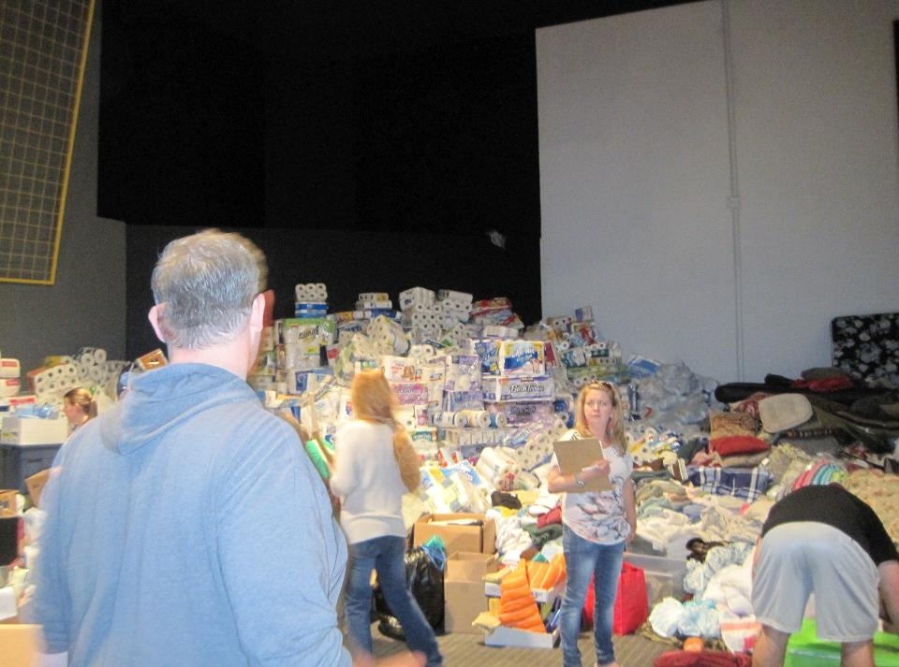

Slide 31
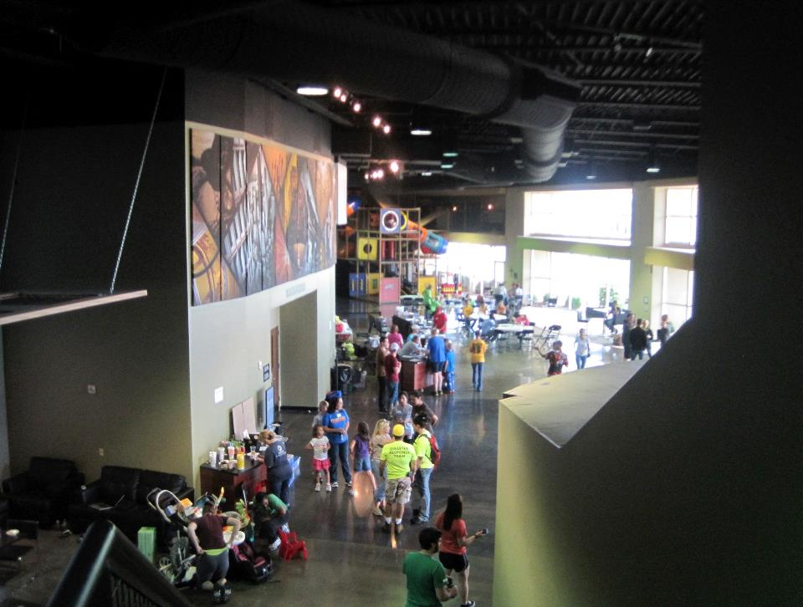

Slide 32
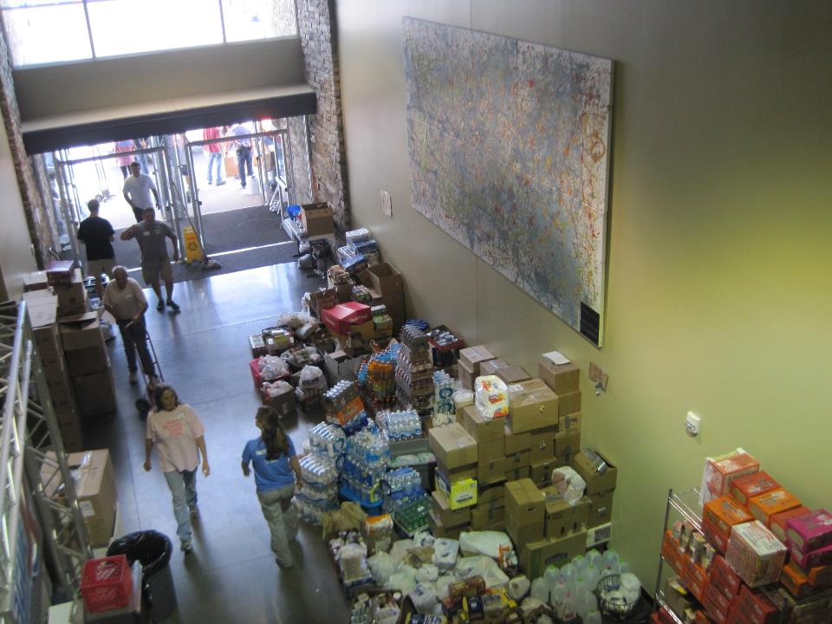

Slide 33
Realization
When we arrived, 500+ volunteers were already on site
Mountains of supplies were arriving
By day 2 – tractor trailers of supplies were arriving
By day 3 – they were overwhelmed with phone calls
By day 4 – structure was settling in with the help of teams coming from the outside
Every room in the sanctuary was filled with supplies or people
Sunday was coming ----- church!!!

Slide 34
Coordinated Plans
Developed an in-house local disaster response plan
Guidelines for safety planning for congregants and staff already in place
Summary of plan (assuming similar event as in Moore)
  Facilities Department – IC
  Disaster response team – Logistics – Volunteers
    Volunteer Reception Center (for our congregants/volunteers)
    Point of Distribution (on site)
    Work orders and response to needs of congregation/community
      Debris removal, tarps, etc.
Notes:
When we returned from Oklahoma, I had a moment when all the excitement and energy of the deployment had subsided and
I thought… “This could happen at our church”. We are of a similar size congregation, demographics, respond to needs in a similar way, are
Equally respected in the community and turned to as leaders in the community. HOWEVER< we had not developed an inhouse plan – WHY, we have always been serving outside of our area and not had an event involving our community directly since 2004.
Our preparation was always about going out. Not responding at our own site. We go busy discussing how we would respond.

Slide 35
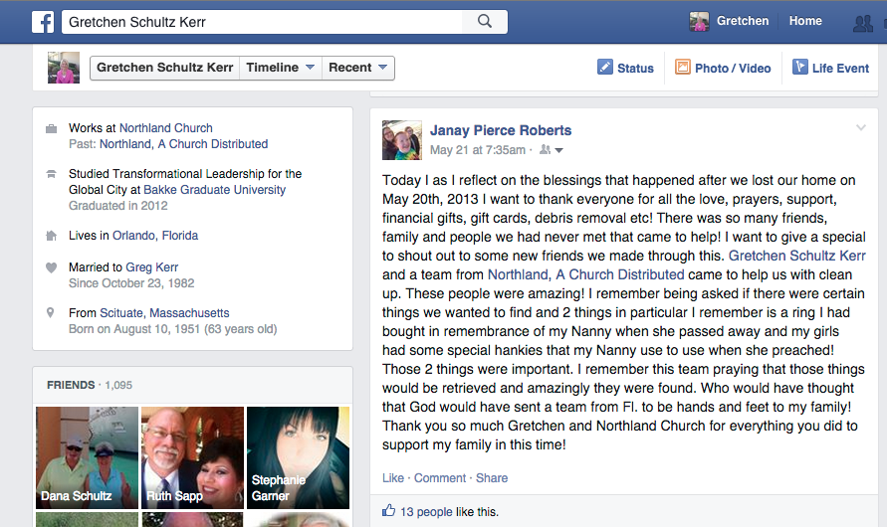
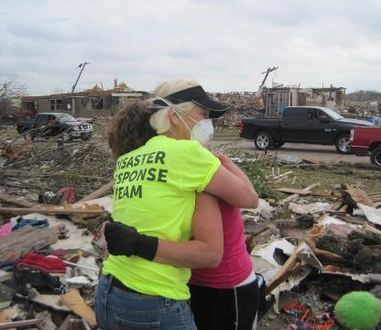
The Reason Why!

Slide 36
QUESTIONS ???

Slide 37
Contact Information
Dr. Gretchen Kerr
Northland, A Church Distributed
Gretchen.kerr@northlandchurch.net
Office: 407-949-7190

